Slide 1




2023HIIDWC
Empathy
国际学生创意设计工作坊/大賽
Huzhou International Innovative Design Workshop ＆ Competition
2023.05.17(三）- 2023.06.07(三）

Slide 2
2023HIIDWC
Empathy
Huzhou International Innovative Design Workshop ＆ Competition
Ｍay. 17- June. 7

Slide 3
2023竞赛主题
『Empathy 同理心』连结联合国在2015年所倡议在2030年达成 「SDGs: Sustainable Development Goals / 可持续发展目标」，期许本校学生透过換位思考去设计，关怀社会去共同创造出美好的世界，以达到「将心比心，设身处地地为他人着想」的理念。
Empathy
同理心

Slide 4
2023竞赛主题
"Empathy" is linked to the United Nations' initiative in 2015 to achieve the "SDGs: Sustainable Development Goals / Sustainable Development Goals" by 2030. It is hoped that the students of our school will design through empathy, care for the society and create a better world together , in order to achieve the concept of "comparing your heart to your heart and putting yourself in the shoes of others".
Empathy
同理心

Slide 5
2023HIITWC日程表
项目 | 时间 | 地点
报名宣传期 | 2023年5月17日(周三）- 2023年5月22日（周一） | 艺术学院
工作坊说明会和分组组队 | 2023年5月24日(周三）14:00 (PM) | 艺术学院7-103视觉传达实验室（暂定）
设计发表会 | 2023年6月7日(周三）10:30 (AM) | 艺术学院7-103 视觉传达实验室（暂定）
颁奖典礼 | 2023年6月7日(周三）14:00 (PM) | 大学生活动中心

Slide 6
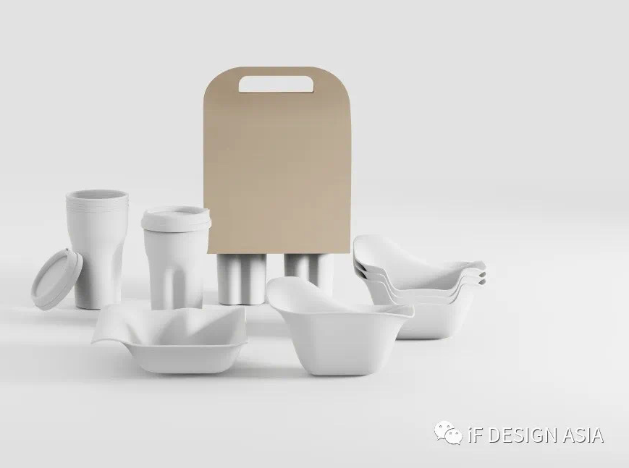
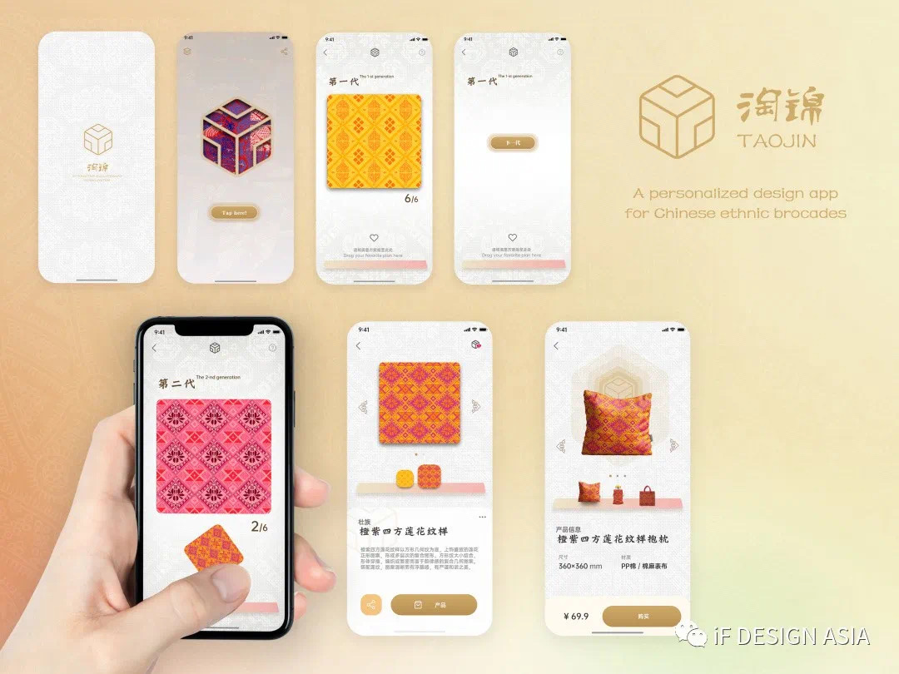
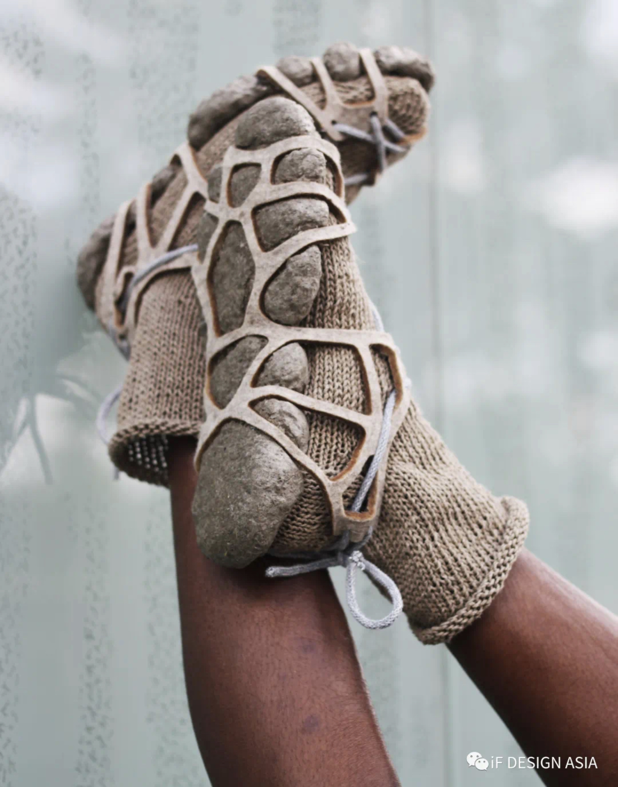
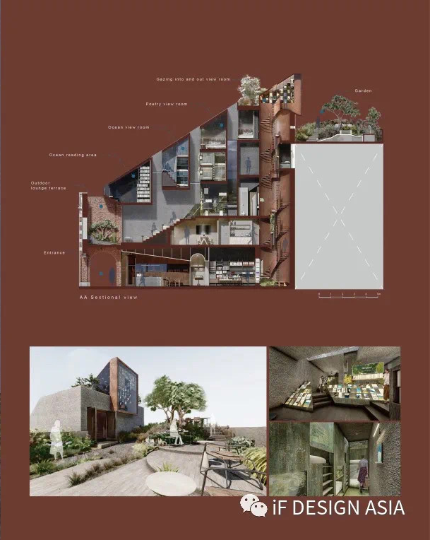
2023HIIDWC Compassion竞赛类别和相關規定
参赛类别可以是产品设计、视觉设计、穿戴设计、环艺建筑等。
参赛者艺术学院研究学生和国际学院工程系所研究学生。透過跨領域的協作、创造力和沟通去解决问题和提出可持续的设计概念。
参与工作坊和竞赛研究生人数定为20人，将于工作坊前进行参与学生分组，原则上４人为一组，各组需自行于工作坊前完成设计概念，将已完成之设计概念提案于工作坊时进行10分钟之简报 。

Slide 7
2023HIIDWC Compassion categories and related regulations
The entry categories can be product design, visual design, wearable design, environmental art architecture, etc.
Participants are research students of the Faculty of Arts and research students of the Faculty of Engineering of the International Faculty. Solve problems and develop sustainable design concepts through cross-disciplinary collaboration, creativity and communication.
The number of graduate students participating in the workshop and competition is set at 24(including 4 international students) and the participating students will be divided into groups before the workshop. In principle, 4 people form a group. Each group needs to complete the design concept before the workshop by itself, and submit the completed design concept to the work. There will be a 10-minute briefing during the workshop.

Slide 8
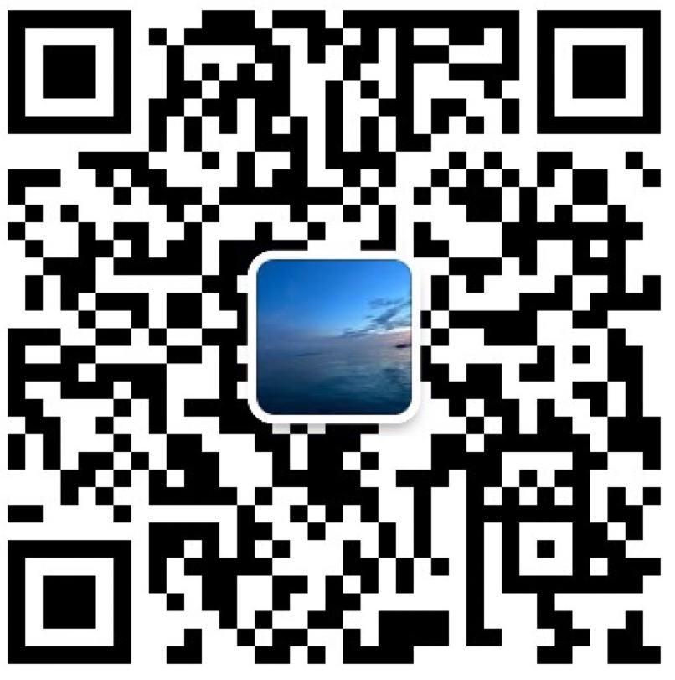
2023HIIDWC 报名和参与规定
步骤一
报名信息发送至02531@zjhu.edu.cn
步骤二
参与说明会与参与学生以四人组队
步骤三
与自己队员合力完成设计方案
步骤四
工作坊当日进行10分钟设计方案汇报
设计简介
解决方案
展示

Slide 9
2023HIIDWC Registration and Participation Regulations
Step 1
Send registration information to 02531@zjhu.edu.cn
Step 2
Participate in the briefing session with participating students in teams of 4 people
Step 3
Work with your team to complete the concept of your design
Step 4
A 10-minute design report on the day of the workshop
Design Brief
Solution
Exhibit

Slide 10
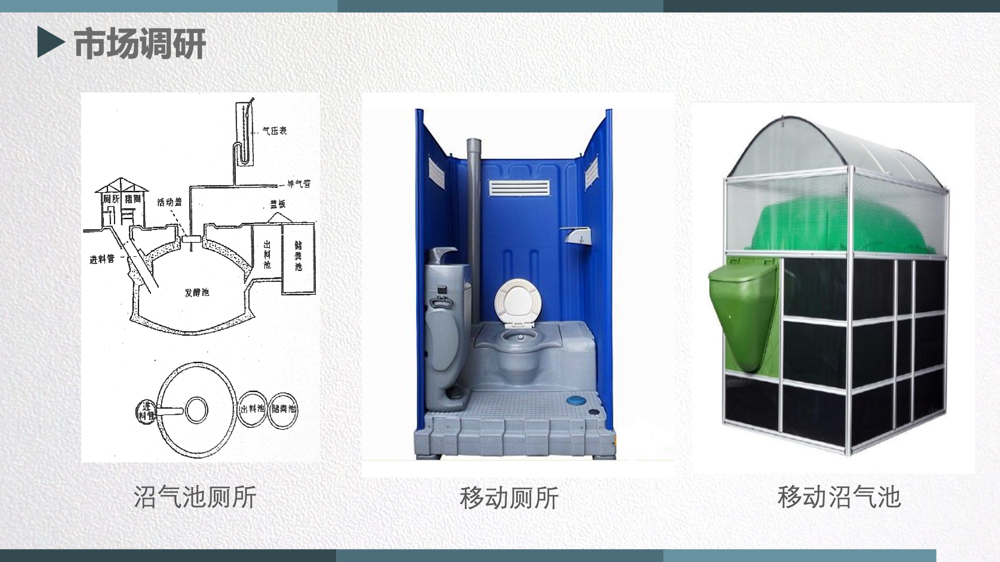
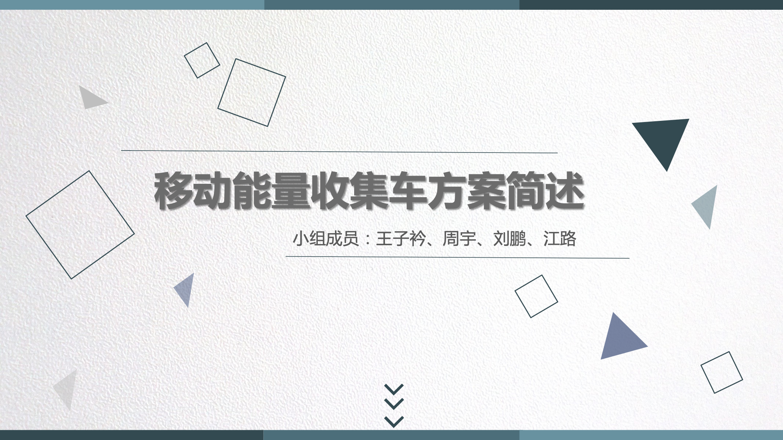
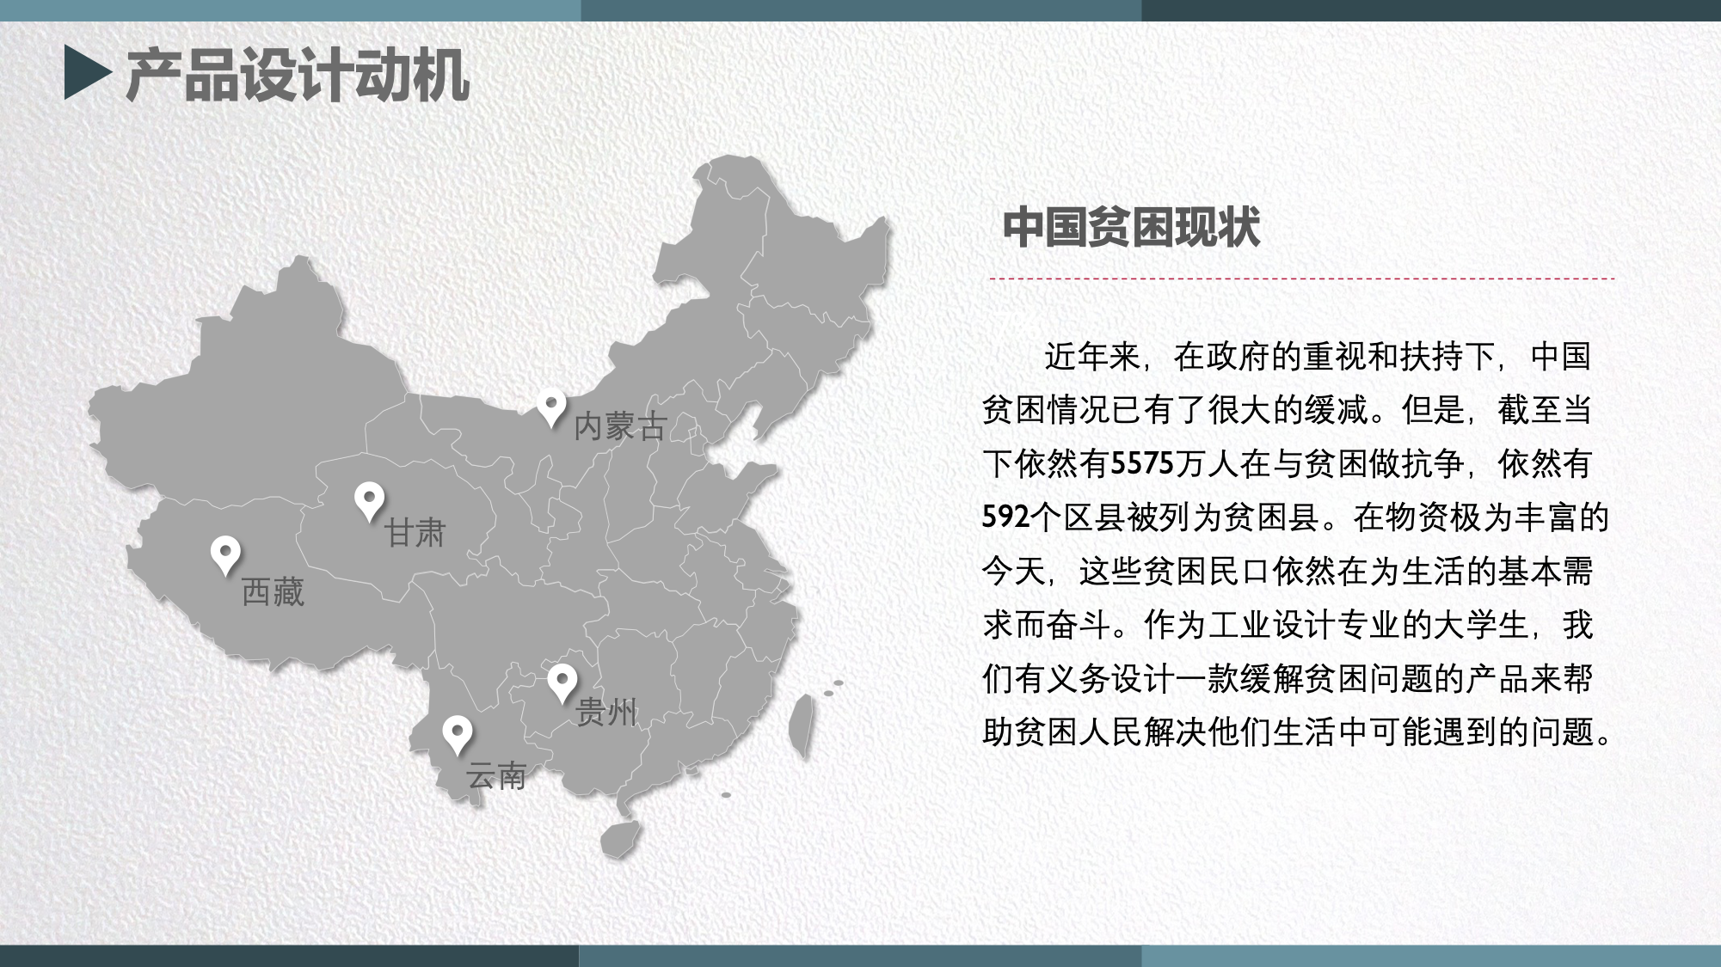
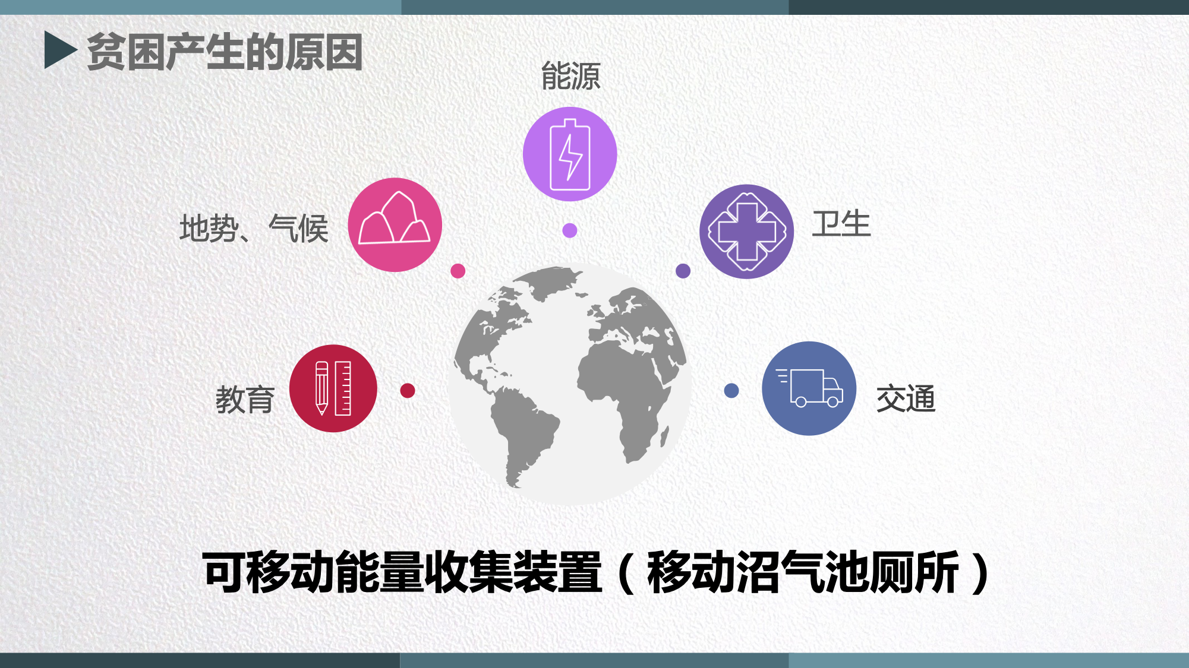
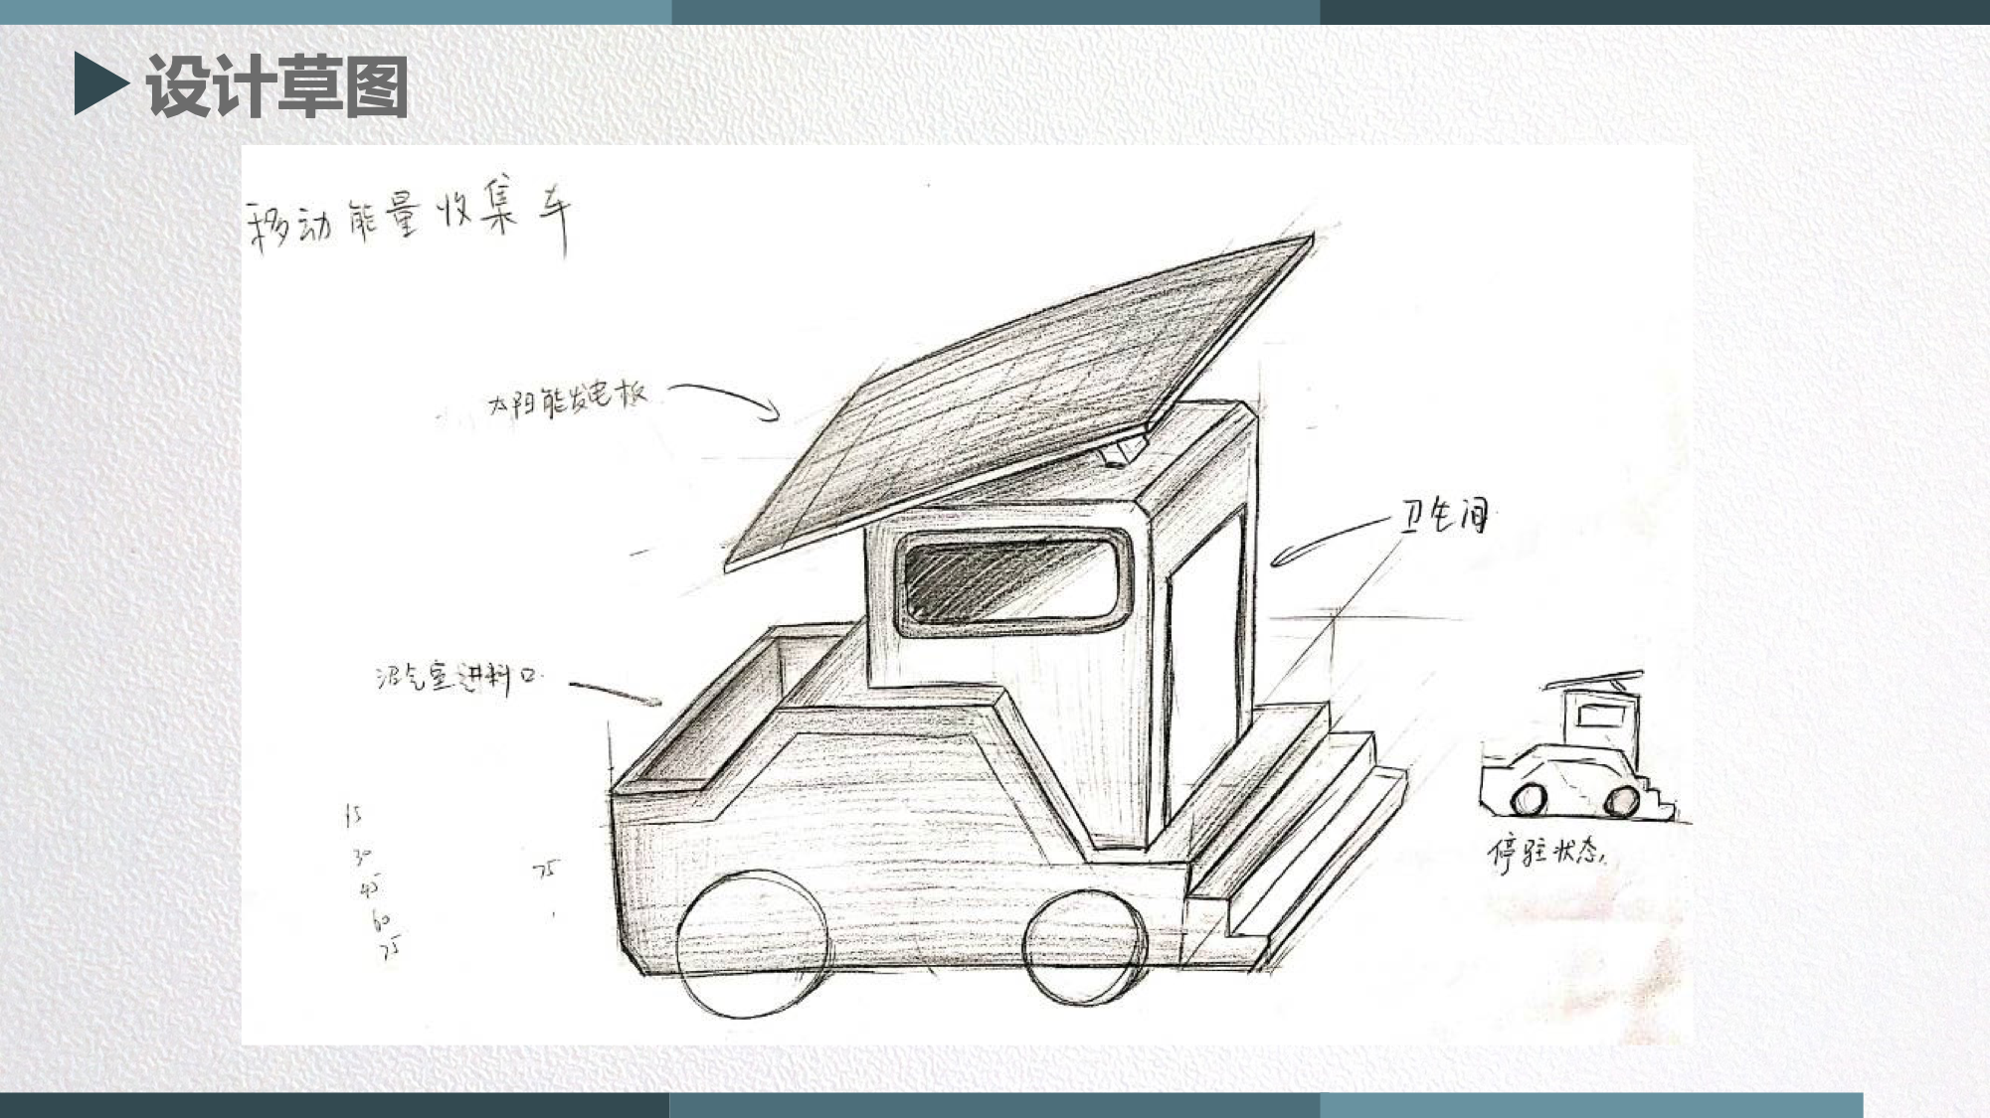
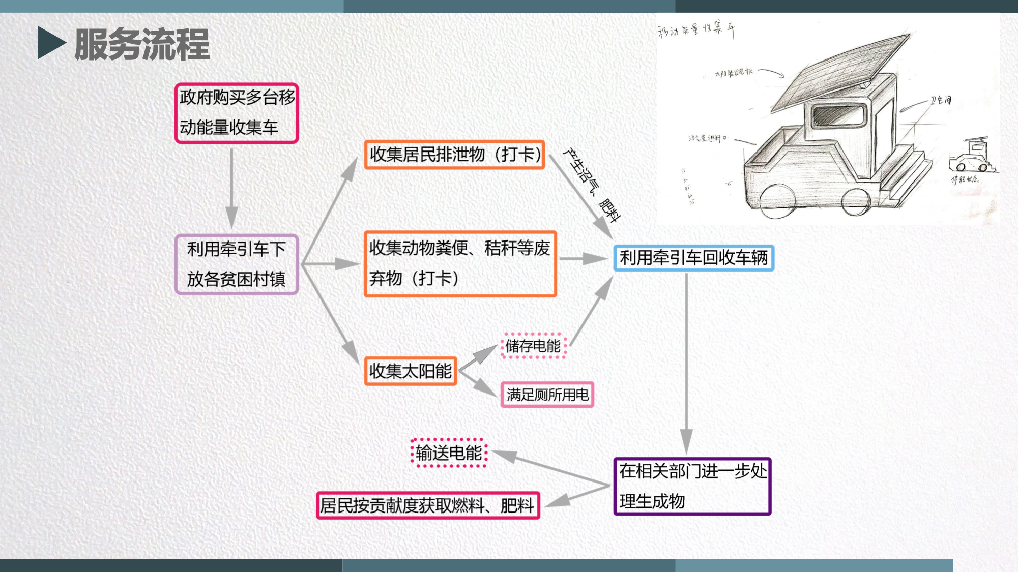
2023HIIDWC 设计概念演示评估标准
使用PowerPoint(PPT)进行设计概念演示。
演示文稿应使用图像和有限的文字来概述原型的开发，包括：
封面（小组姓名、产品名称）;
背景介绍（研究背景、动机与目的、问题分析）;
思维导图（针对所选主题去发展绘制，尽量以图无并茂）;
产品概念设想
草图和情节提要;

Slide 11

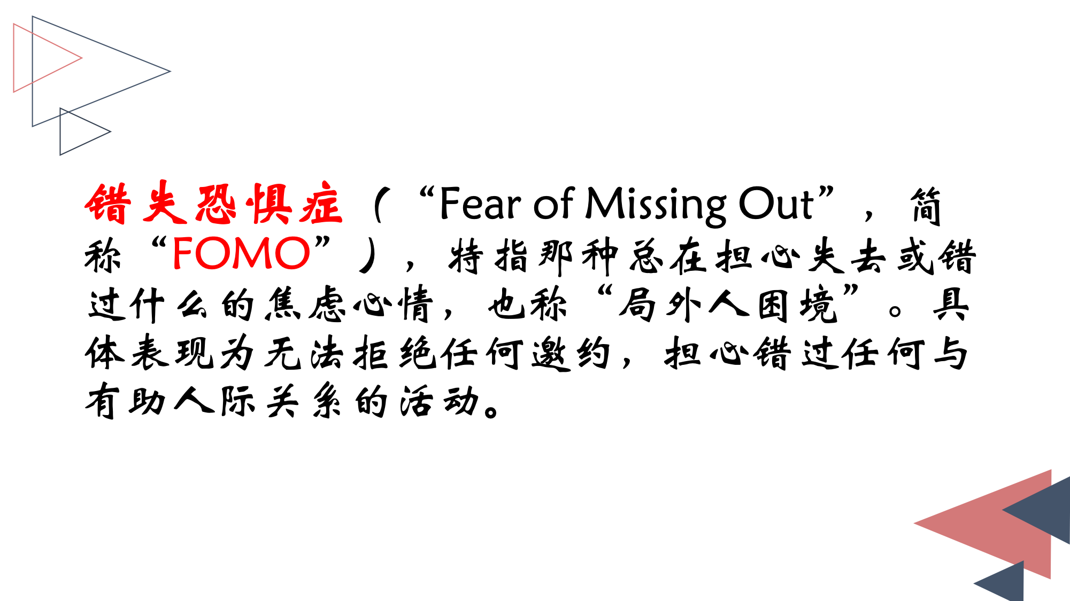
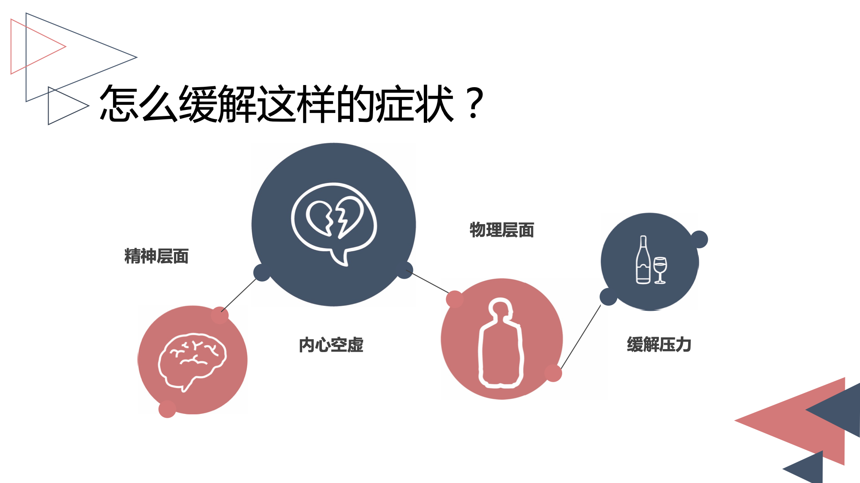

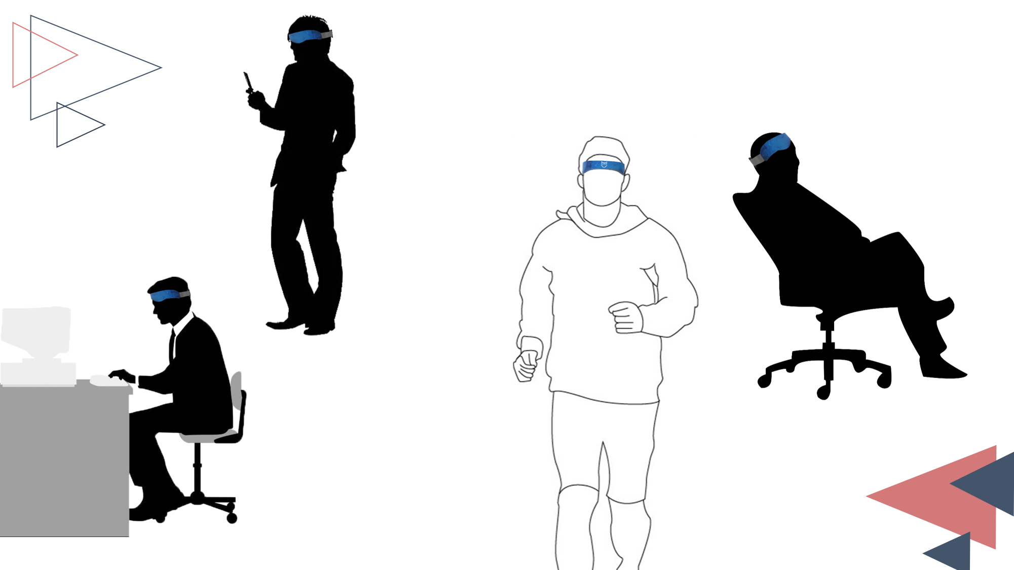
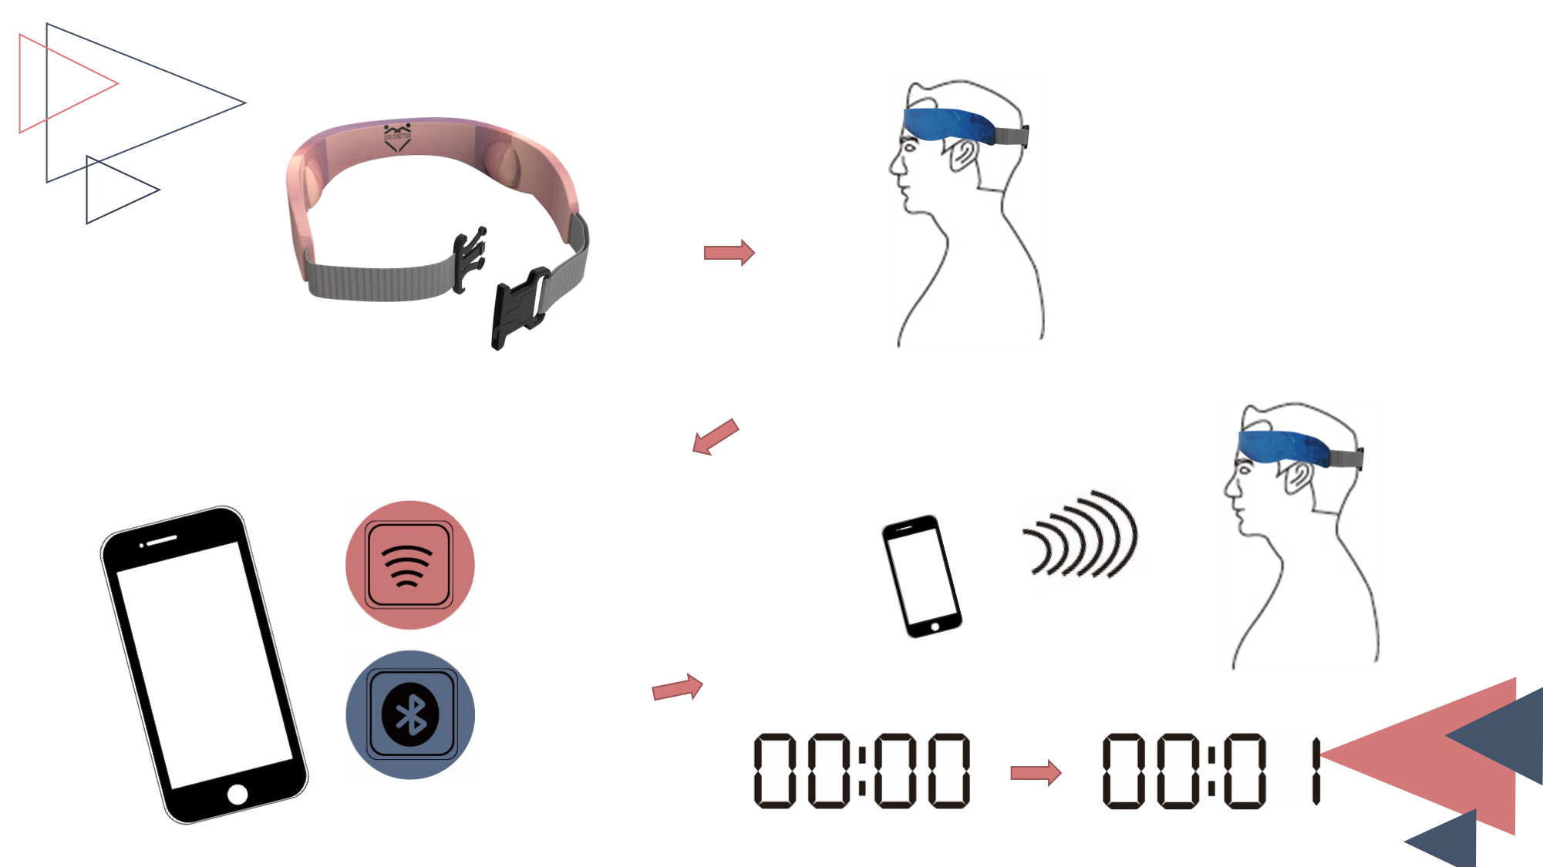
2023HIIDWC 设计概念演示评估标准
Use PowerPoint (PPT) for design concept presentation.
Presentations should use images and limited text to outline the development of the prototype, including:
Cover (Team member name, Product name);
Background introduction (research background, motivation and purpose, problem analysis);
Previous Product Concept Ideas
Sketches and Storyboards;

Slide 12

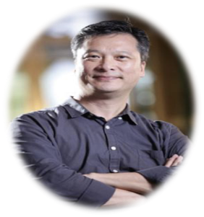
2023HIIDWC 国际设计奖专家评委简介
1988-1997年间李任职于外贸协会设计推广中心 (台湾创意设计中心的前身)，从事设计推广之工作，期间曾担任产品与包装设计杂志的主编，规划与执行「全面提升产品形象计划」与「商业环境视觉设计计划」，负责「国家产品形象奖」、「台湾精品」之评审作业；并曾管控ICSID '95 TAIPEI世界设计大会文宣品之规划设计，任职期间在协助辅导企业提升商业设计，建立企业识别体系上有多年之经验。
1997-2000年间李被外贸协会外派至德国杜塞道夫台湾贸易中心，从事促进台湾与德国双边贸易之各项推广工作，其后李投入IT产业从事营销之业务，并曾担任瀚斯宝丽 (Hannspree) 之设计部门主管。2006年李受邀任职台湾纺织业拓展会，并举办首届「台北魅力」时尚展，2007年李加入iF团队，成为iF亚洲子公司、iF深圳公司与iF成都公司负责人，负责提供设计推广相关之服务，同时担任华人与欧洲之间文化与经济交流之桥梁。
李于iF工作期间曾筹办「iF中国设计大奖」、「台北国际计算机展创新设计奖」、「台北自行车展创新设计奖」、「全球自行车设计比赛」、「家居风尚大奖」、「成都国际家居设计奖」等奖项、「iF国际设计论坛成都」以及多项iF在大中华区的设计展出。另外亦曾受邀担任台湾国际学生创意设计大赛、光宝创新奖、育秀杯创意奖、裕隆日产汽车创新风云赏、奇想设计大赛、U19全国创意发明竞赛、台中杯全国创意大奖、美律工业设计奖、新燃点设计竞赛、中国设计智造大奖等奖项之评审委员。
李建国
iF国际论坛设计有限公司亚洲子公司 总经理

Slide 13

2023HIIDWC Introduction of International Design Award Expert Judges
From 1988 to 1997, Mr.Sean worked in the Design Promotion Center of the International Trade Association (the predecessor of the Taiwan Creative Design Center), engaged in design promotion. Business Environment Visual Design Program", responsible for the review of "National Product Image Award" and "Taiwan Excellence"; and once managed the planning and design of the ICSID '95 TAIPEI World Design Conference's promotional products. There are many years of experience in the corporate identity system.
From 1997 to 2000, Mr.Sean was dispatched by the Foreign Trade Association to the Taiwan Trade Center in Dusseldorf, Germany, to be engaged in the promotion of bilateral trade between Taiwan and Germany. (Hannspree) Head of Design Department. In 2006, he was invited to work at the Taiwan Textile Industry Development Conference and held the first "Taipei Charm" fashion exhibition. In 2007, he joined the iF team and became the head of iF's Asian subsidiary, iF Shenzhen and iF Chengdu, responsible for providing design and promotion related information. At the same time, it serves as a bridge for cultural and economic exchanges between Chinese and Europe.
During his work at iF, Mr.Sean organized the "iF China Design Award", "Taipei International Computer Show Innovation Design Award", "Taipei Bicycle Show Innovation Design Award", "Global Bicycle Design Competition", "Home Fashion Award", "Chengdu International Furniture Design Award" and other awards, "iF International Design Forum Chengdu" and a number of iF design exhibitions in Greater China. In addition, he has also been invited to be the director of Taiwan International Student Creative Design Competition, Lite-On Innovation Award, Yuxiu Cup Creative Award, Yulon Nissan Motor Innovation Award, Fantastic Design Competition, U19 National Creative Invention Competition, Taichung Cup National Creative Award, Merry Industry Judging committee for Design Award, New Randian Design Competition, China Design Intelligence Award and other awards.
Sean Lee
General Manager of Asia Subsidiary of iF International Forum Design Co., Ltd.

